Slide 1
Diversity, Equity & Inclusion in Data Architecture
Edward Pollack
Data Architect
Transfinder
Data Platform MVP

Slide 2
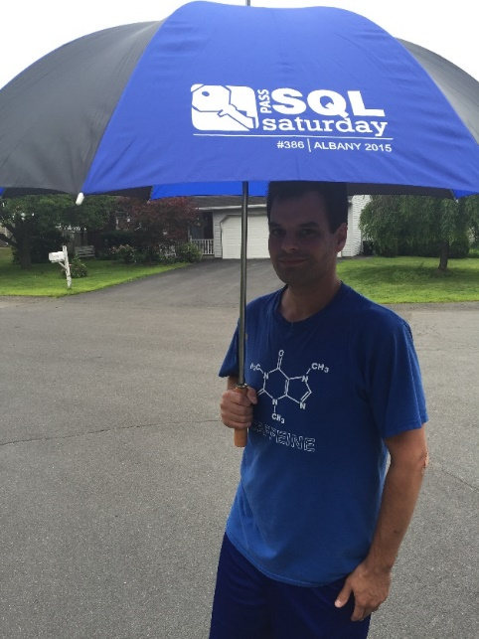



Ed Pollack
Microsoft Data Platform MVP
Published author of:
Dynamic SQL: Applications, Performance, and Security, 2nd Edition
Published author of Analytics Optimization with Columnstore Indexes in SQL Server
Published in Expert T-SQL Functions in SQL Server, 3rd Edition
Expert T-SQL Indexing in SQL Server, 4th Edition
Author on SQLServerCentral, SQLShack, and SimpleTalk.
Organizes:
SQL Saturday New York City
Future Data Driven
Capital Area SQL Server User Group
Speaker at many data events Twitter: @EdwardPollack

Slide 3








SQL Saturday New York City 2023
A BIG Thank You to our Sponsors
Platinum
Gold
Bronze

Slide 4
What is Diversity, Equity & Inclusion
DIVERSITY: The variance between people and groups represented in any population.
Such as gender, age, sexuality, economics, ethnicity, neurodiversity…
EQUITY: Treating people fairly (not just equally). Providing opportunities to succeed that take into account individual circumstance.
Handicap access, fair pay/benefits, transportation, access to tools…
INCLUSION: Providing opportunities to everyone in an organization/group, ensuring everyone is valued & respected.

Slide 5
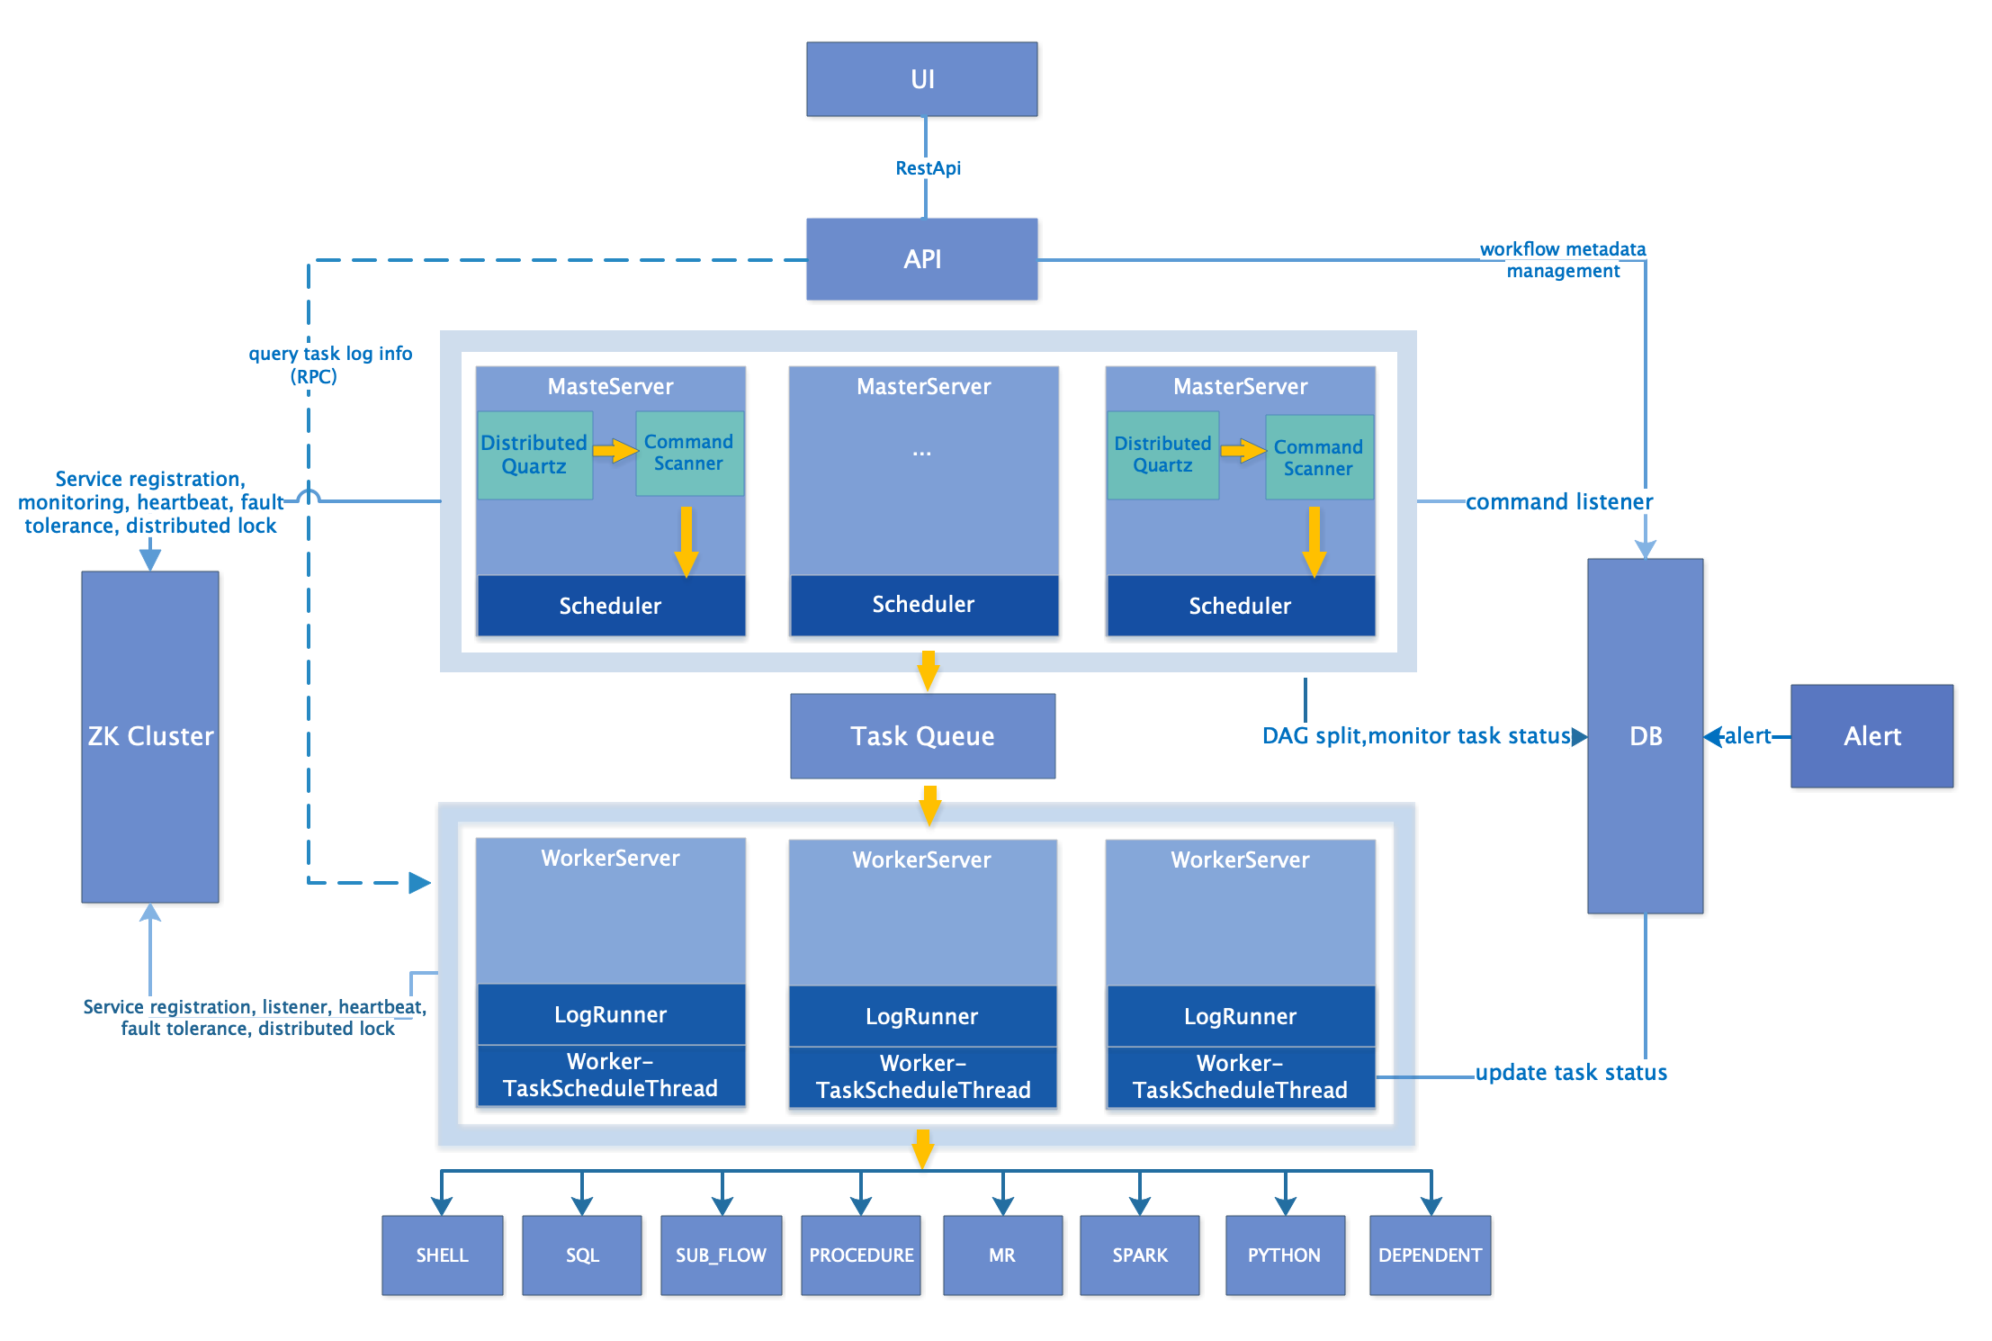
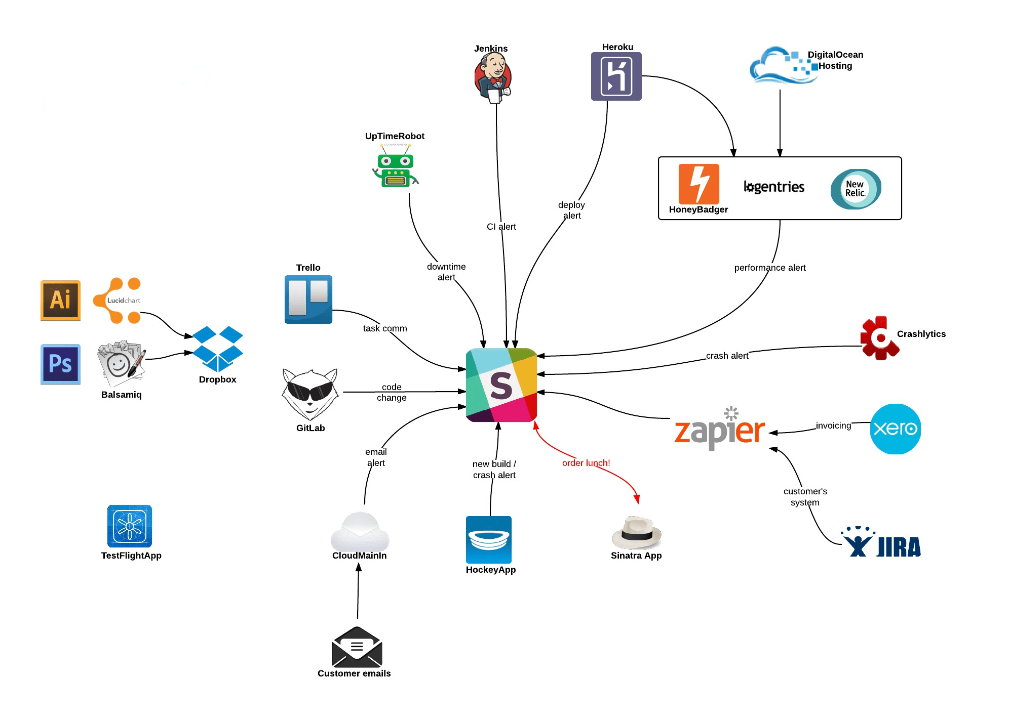
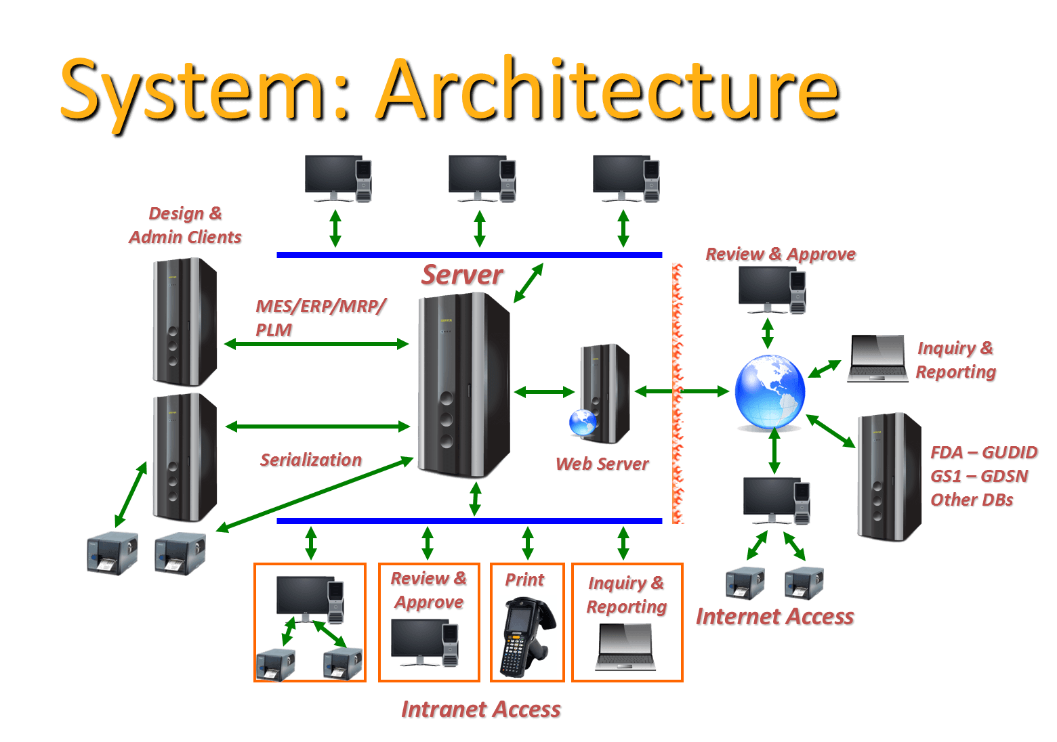
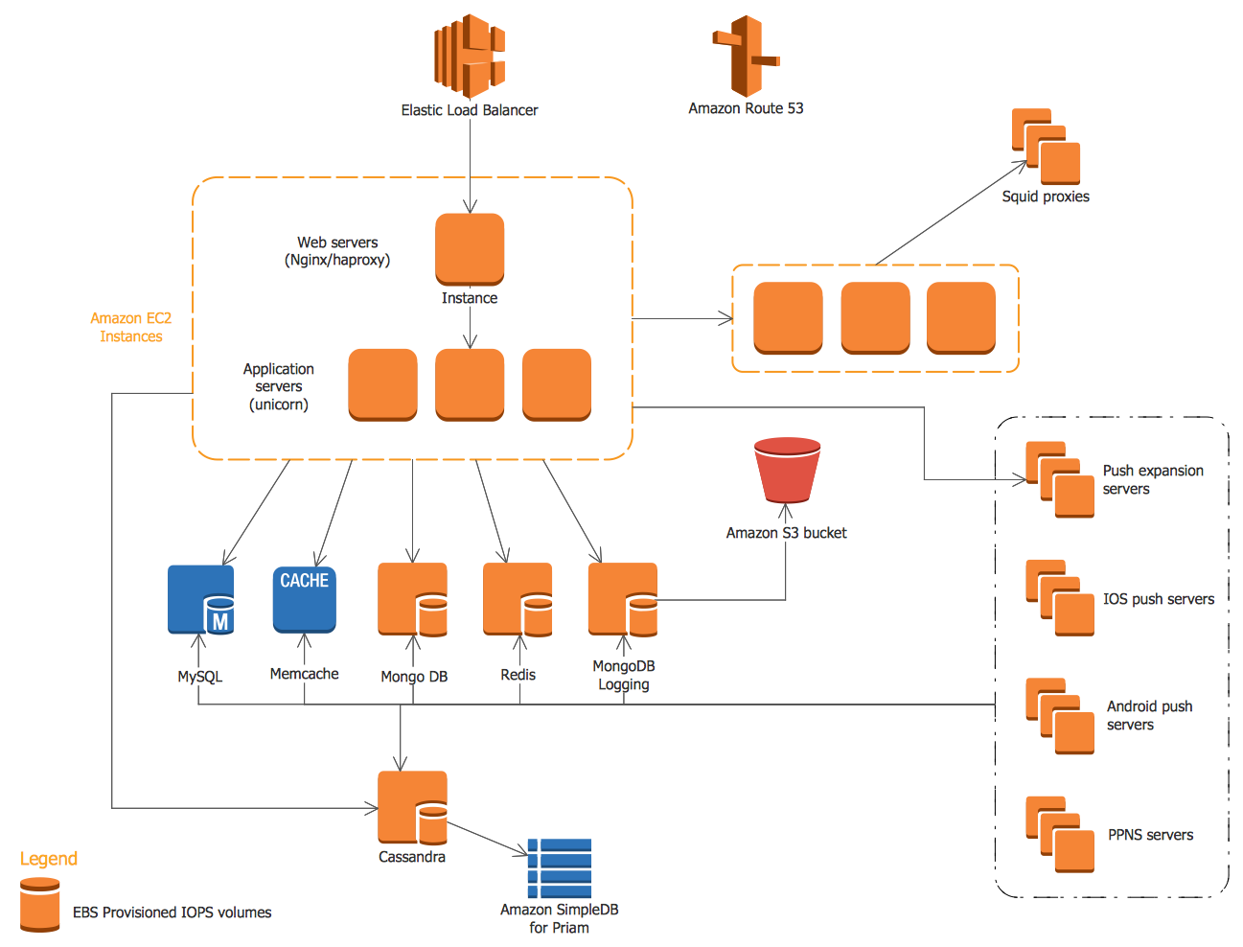
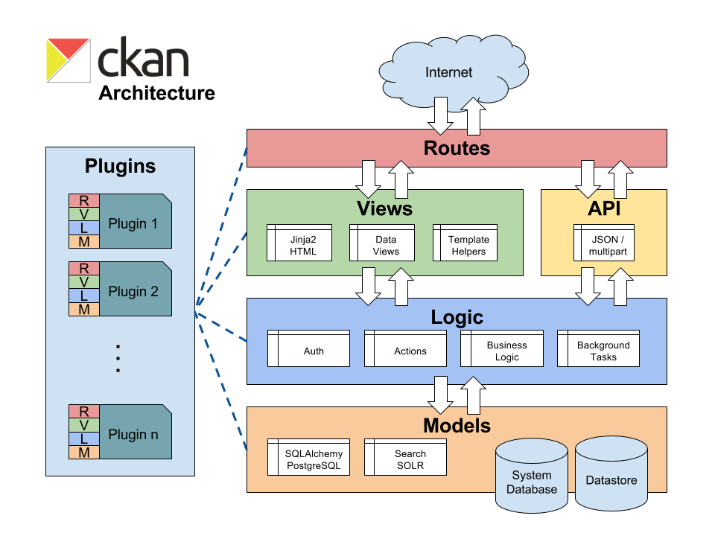
What we do:

Slide 6
What is This Presentation About?
THE USER!

Slide 7
The Problems
Poor user experience.
Marginalized people.
Apps that do not work correctly/effectively for everyone.
Apps that discourage people from using them.
Data sets that are biased and/or inaccurate.
Poor decision-making.
Hiring challenges.
Lost revenue.
Legal challenges.
These issues compound each other over time, affecting more & more users.

Slide 8
The Solution (aka: The Rest of this Presentation)
Consider your users.
Who are they?
What are their backgrounds?
Are reviews skewed based on age, nationality, language, gender, etc…
How can your app be friendlier to more users?
How do your coworkers, teams, and departments relate to users?

Slide 9
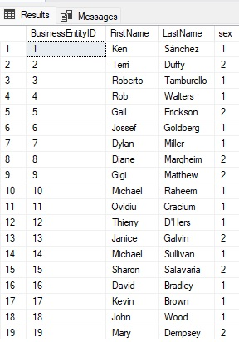
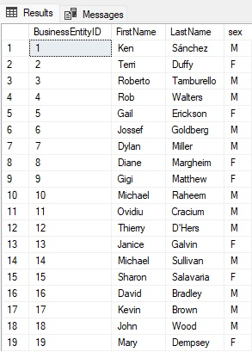
Change is a Part of Life
What was acceptable in the past may not be today.
What is acceptable today may not have been in the past.
Consider Gender:
???

Slide 10
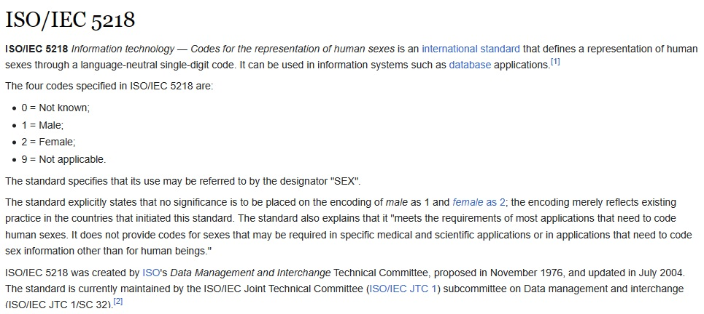
Standards: Helpful…But Not Always Complete

Slide 11
Consider Non-Binary Solutions
More than 2 options
Gender <> Pronouns
Consider lookup tables
Allows for change/additions over time.
Consider freeform text
Allows for complete customization.
Avoid default values!

Slide 12
Consider Compound/Dynamic Solutions
First Name + Middle Name + Last Name → Full Name
Address1 + Address2 + City + State + Zip → Address
Area Code + Prefix + Line Number → Phone Number
Have field lengths long enough to accommodate this!
Avoids splitting fields based on spaces, commas, etc…
Allow fields to be changed. Most attributes are not permanent.

Slide 13
Do We Need <This> Data?
Mistakes and bias come from somewhere.
That somewhere can easily be unneeded data.
Do not store data unless it serves an organizational purpose:
Gender
Pronouns
Birth name
Social Security #
Credit card #
Drivers license #
Social media
Personal preferences
Etc…
This is very important in areas like sales/marketing!

Slide 14
Pronouns
More modern and inclusive than prefixes (Mr, Mrs, Ms, Dr…).
May not be needed in all applications.
Do not restrict values.
Freeform text may lead to junk data. No problem ☺

Slide 15
Internationalization & Localization
Consider formats for:
Names
Addresses
Nationality
Language
Time
Numbers
Special characters
All of them ☺

Slide 16
Analytic Challenges
Lack of clarity leads to unauthoritative/vague results.
Data quality.
Data diversity.
Data quantity.
Goals/incentives dictate analytic conclusions.
Bias

Slide 17
Correlation <> Causation
Proving that one event CAUSES another is far more challenging than showing they are related.
Implying causality without proof is dangerous.
Invalid conclusions can implicate or marginalize groups.
Socioeconomics strongly skews and drives data:
Will chocolate and wine help you live longer? Only if you can afford them…
Breakfast improves grades? Only when a school provides it for free.
Do baths reduce heart disease? If you have the free time to take them often.
Do worse grades in school imply bad teachers, schools, students, parents?

Slide 18
Representative Data and Outliers
Is the data set used for analysis representative of a diverse population?
When outliers are removed from a data set, what is left?
Are outliers indicative of a specific group of people?
Beware data derived from polls or voluntary submission.

Slide 19
Representative People
Is your technical staff diverse?
Developers, architects, QA, product managers, designers, managers…
If not, creating an inclusive app is NOT easy.
Do technical people understand how their apps work?
Do technical people understand who uses their apps?
Can data elements be easily mapped to application features?

Slide 20
Accessibility
Is it usable by:
Vision impaired
Hearing impaired
Younger users
Older users
Mobile users
What is the setting in which an application is used?
Can the app run on most hardware?
Does it require a certain level of education/cultural knowledge?
Does it require a certain level of language proficiency?
Do data structures support these accessibility goals?

Slide 21
AI/Machine Learning
AI is not magic. Computers do not think for themselves (yet).
Algorithms are written by people.
They consume data created by people.
Therefore, they can produce bias.
Leads to automation of previously traditional jobs.
Is that OK?
Databases represent automation (filing cabinets, paper, and pen).
Be cognizant of the implications of automation.
Who is removed? What is removed? What is created? How do processes change?

Slide 22
Conclusion
Understanding an application’s users will:
Improve usability
Reach new users
Create happier and more engaged users
Decrease bugs/vulnerabilities
Increase revenue
Connect data at all levels to users.
Improving diversity is a journey.

Slide 23
Thank You!
Edward Pollack
@EdwardPollack
ed@edwardpollack.com
Ed Pollack | LinkedIn

